Slide 1
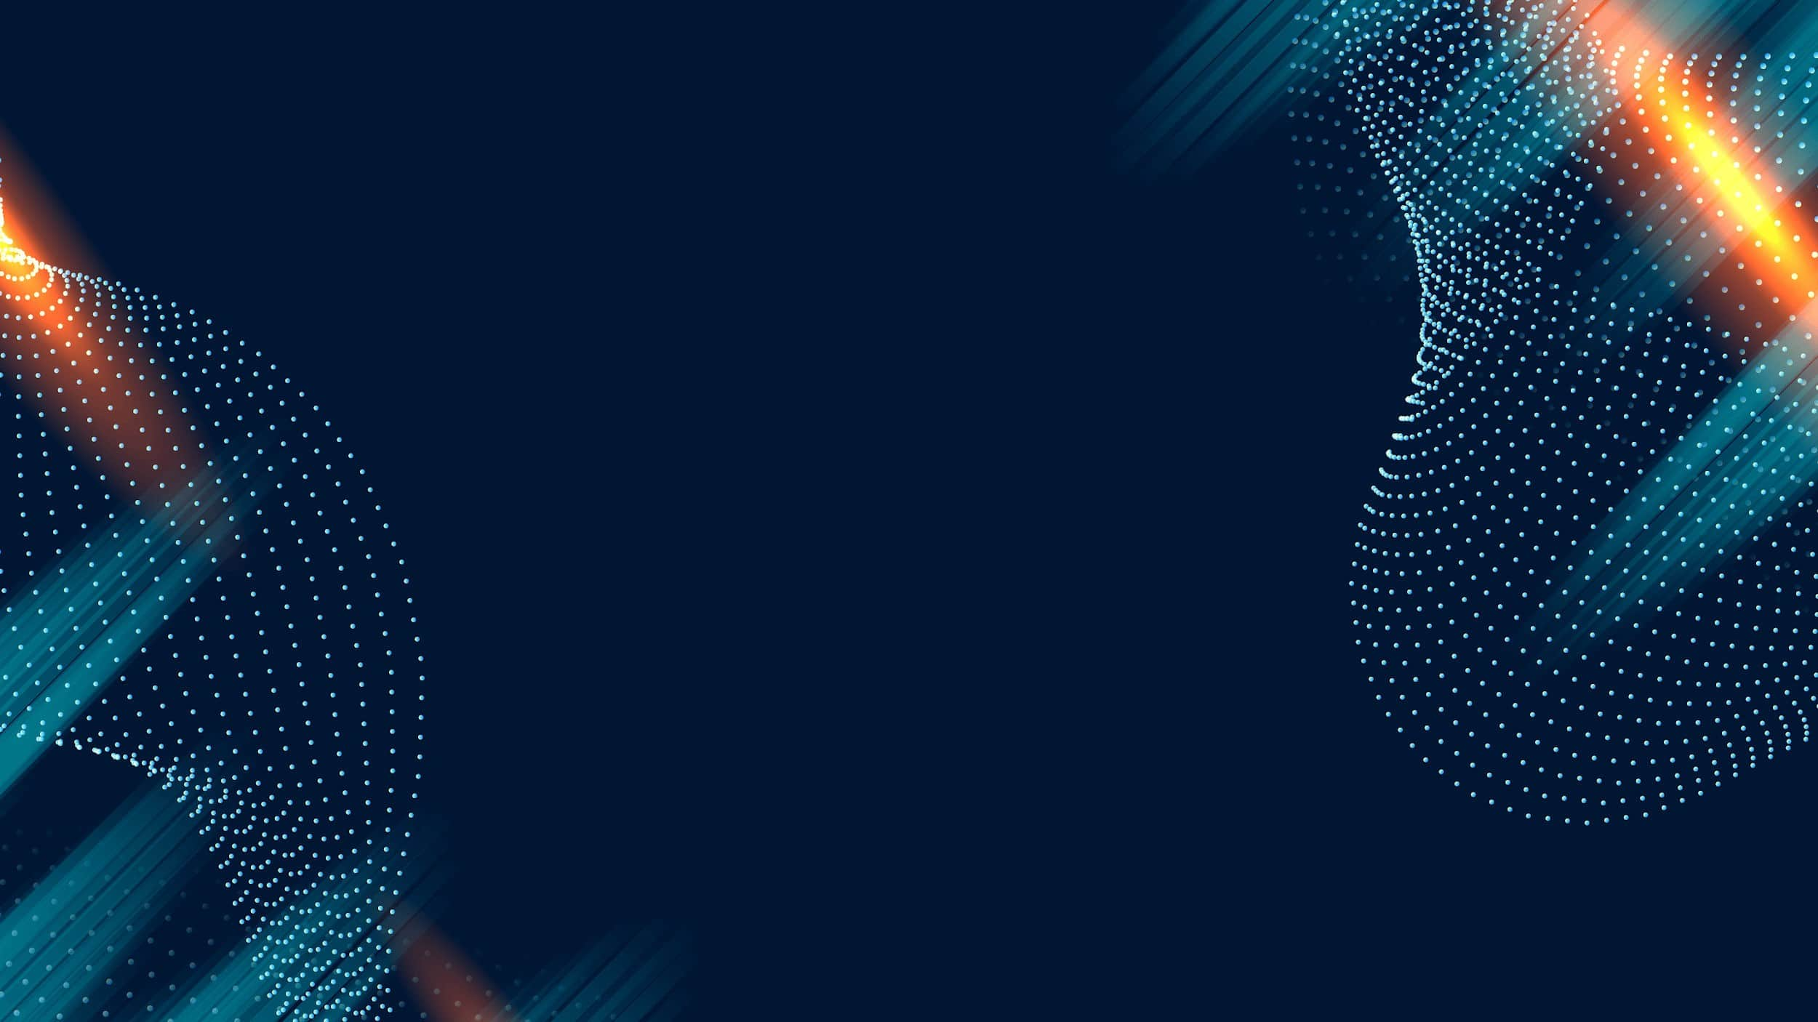

TumorTrace: Breast Cancer Detection
Name: Jaya Madhav Beere
Theme : AI First
Platform : Infosys Springboard
Mentor: Anurag Sista

Slide 2

Project Overview
Objective:
Develop a machine learning model to classify breast cancer status (benign or malignant) using MRI images.
Goal:
Facilitate early detection of breast cancer to enhance patient outcomes.
Approach:
Implement deep learning models, perform data preprocessing, and evaluate model performance using appropriate metrics.

Slide 3
Problem Statement
The Problem:
Breast cancer is a leading cause of death among women worldwide.
Early detection plays a vital role in improving survival rates.
Manual analysis of MRI scans is slow, expensive, and prone to errors.
The Need:
Create a fast, accurate, and automated solution for MRI scan classification, aiding early and reliable cancer detection.
We develop a deep learning model that can accurately classify MRI images as benign or malignant

Slide 4

Step by step approach
Overview:
Gather MRI datasets with labels.
Preprocess data to prepare for model input.
Train and evaluate neural networks.
Key Steps:
Data Acquisition: Collect labeled MRI images.
Preprocessing:
Convert images to grayscale.
Resize (e.g., 224x224).
Normalize pixel values.
Apply augmentation (rotation, flipping).
Manage class imbalance with oversampling or weights.
Model Development: Train AI models like VGG16 and ResNet.
Performance Assessment: Use metrics like accuracy, precision, recall, and F1 score.

Slide 5
AI models applied
VGG16: A 16-layer convolutional network for effective classification
ResNet Variants: ResNet18 and ResNet50 offer deeper architectures with residual connections to prevent degradation
Process Followed:
1. Start with pre-trained architectures.
2. Fine-tune using the MRI dataset.
3. Train and validate results.

Slide 6

Key Performance Indicators
Metrics Used:
Accuracy: Correct classifications out of total samples.
Precision: Measure of avoiding false positives.
Recall: Rate of detecting actual positives.
F1 Score: Harmonizes precision and recall.
AUC (Area Under Curve): Evaluates model's ability to distinguish between classes.
Confusion Matrix: Offers a detailed breakdown of predictions and misclassifications.

Slide 7
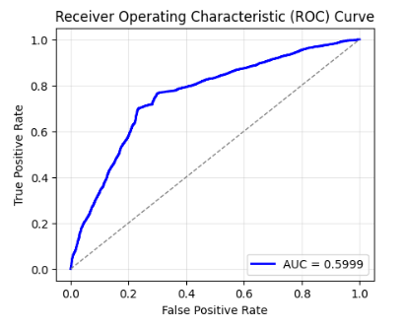
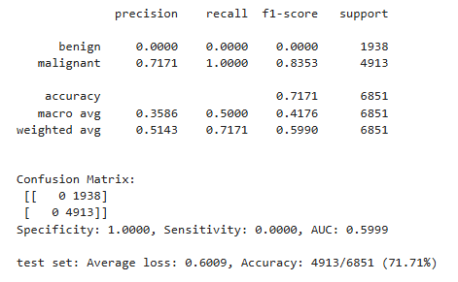
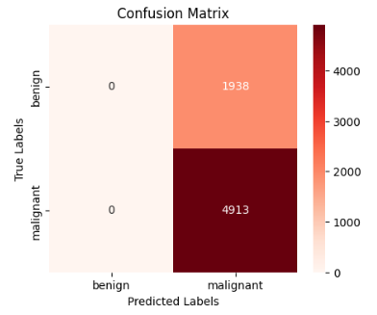
Outcomes and Learnings
Model – VGG16

Slide 8
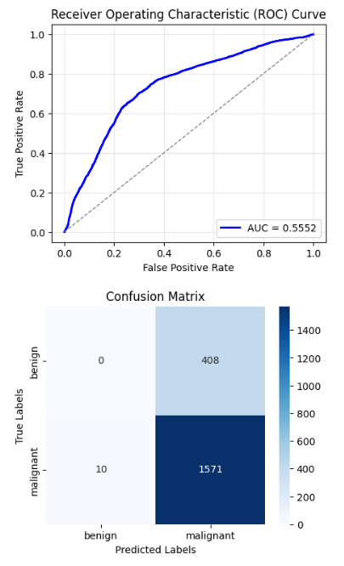
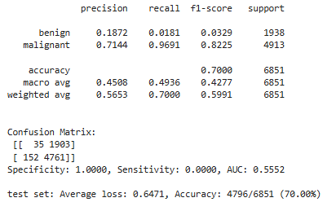
Outcomes and Learnings
Model – ResNet18

Slide 9
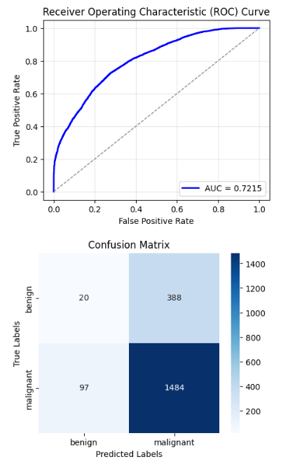
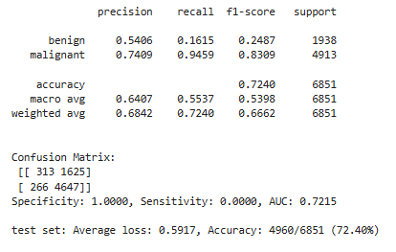
Outcomes and Learnings
Model – ResNet50

Slide 10

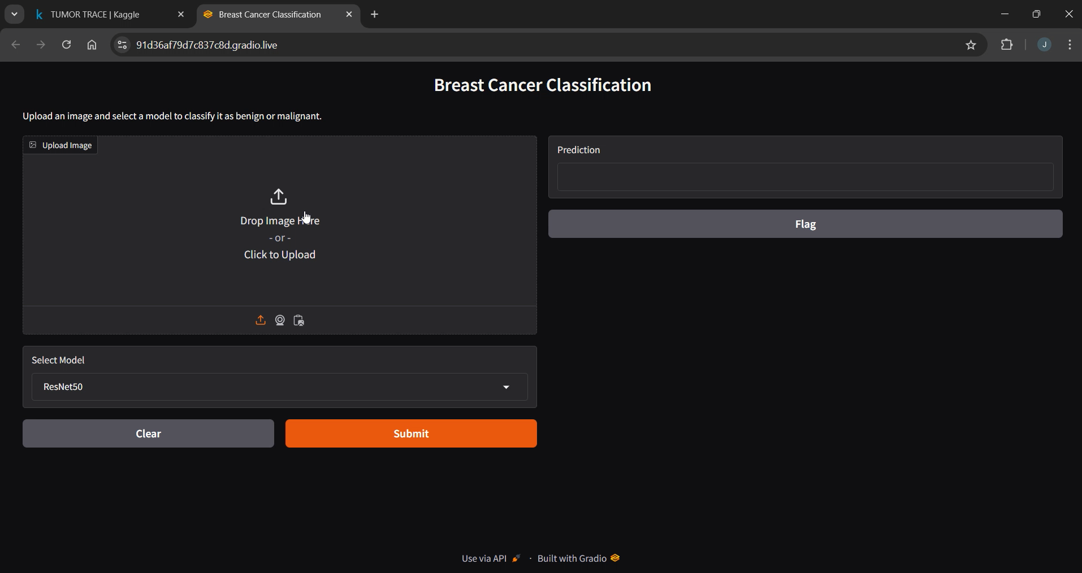

Slide 11

Thank You

